Slide 1
PREDICTING HEART DISEASE
Presentation by,
S.Saravanan,
Data Science Research Scholar

Slide 2
HEART DISEASE
Heart disease refers to any condition affecting the heart. There are many types, some of which are preventable. Unlike cardiovascular disease, which includes problems with the entire circulatory system, heart disease affects only the heart.

Slide 3
TYPES
Arrhythmia. An arrhythmia is a heart rhythm abnormality.
Atherosclerosis. Atherosclerosis is a hardening of the arteries.
Cardiomyopathy. This condition causes the heart's muscles to harden or grow weak.
Congenital heart defects. ...
Coronary artery disease (CAD). ...
Heart infections.

Slide 4
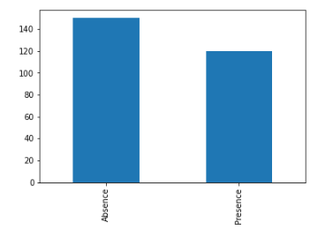
HEART DISEASE
As per the dataset, Heart disease is absent in most people

Slide 5
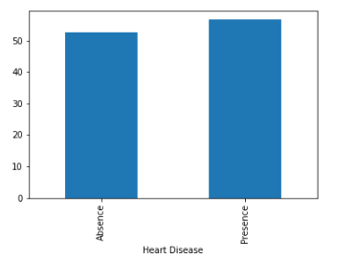
Heart Disease Vs Age Group
It may affect any age group, but more susceptibility is found in older age group above 50.

Slide 6
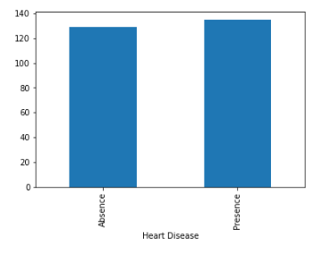
Heart Disease Vs BP
Heart Disease affects patients whose BP above 120

Slide 7
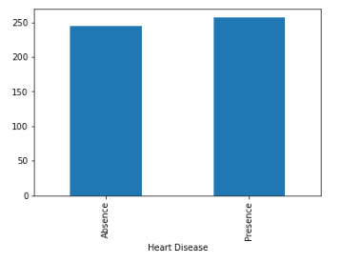
Heart Disease Vs Cholesterol
For cholesterol above 250, there is a good chance of heart disease

Slide 8
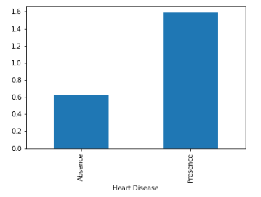
Heart Disease Vs ST Depression
When ST depression curve is more than 0.6, there is a high chance of heart disease

Slide 9
Model
Random Forest Model is used
Accuracy Score – 79%
Recall Value – 62.5%

Slide 10
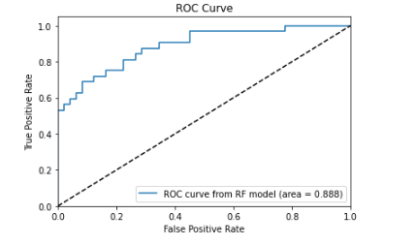
RoC Curve

Slide 11
Features of Importance
Chest pain type
Thallium
ST depression
Number of vessels fluro
Max HR

Slide 12
ST depression in ECG
ST depression in ECG at entry indicates severe coronary lesions and large benefits of an early invasive treatment strategy in unstable coronary artery disease; the FRISC II ECG substudy. The Fast Revascularisation during InStability in Coronary artery disease.

Slide 13
Thallium stress test
A thallium stress test is a nuclear imaging test that shows how well blood flows into your heart while you’re exercising or at rest. This test is also called a cardiac or nuclear stress test.

Slide 14
FCI
FCI is a novel technology to visualize coronary vessels and myocardial perfusion intraoperatively using the indocyanine green dye with an infrared-sensitive imaging device.

Slide 15
Maximum Heart Rate
Maximum Heart Rate decides whether a person will get Heart disease or not

Slide 16
Thank You

